Slide 1


Aggregate Operations: An Overview
Aggregate operations are powerful tools for summarizing and analyzing data. They allow you to condense large datasets into meaningful insights.

Slide 2

What are Aggregate Operations?
1
Data Reduction
2
Summary Statistics
Aggregate operations reduce data to a more manageable size by combining similar data points.
Aggregate functions calculate metrics like count, sum, average, minimum, and maximum for a dataset.
3
Trend Analysis
Aggregate operations help identify patterns and trends in data, enabling better decision-making.

Slide 3
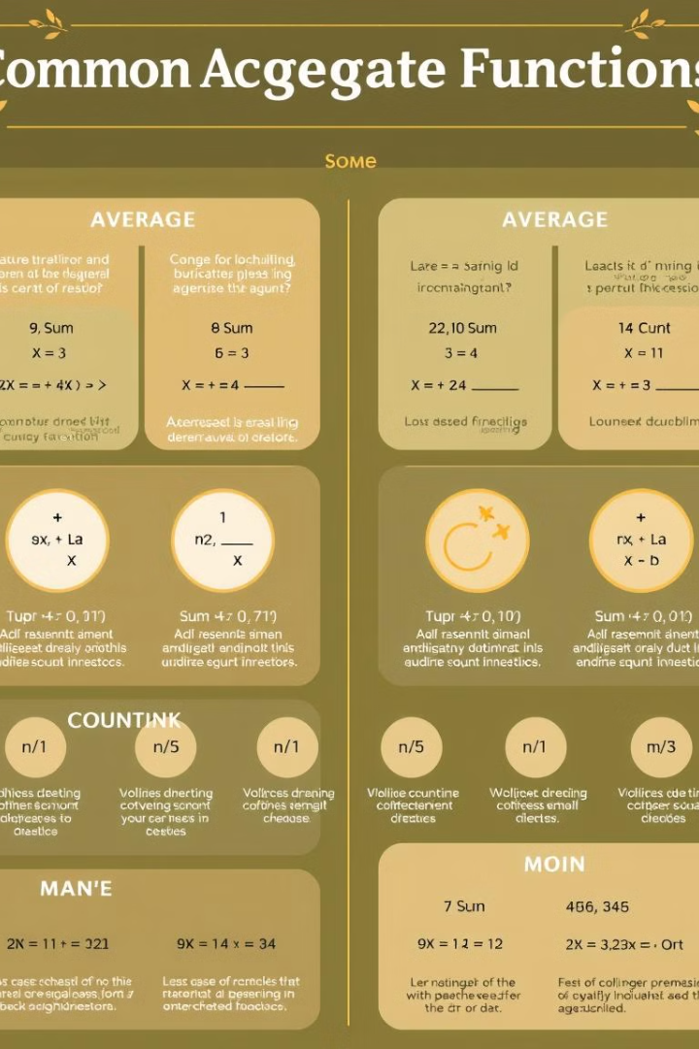
Commonly Used Aggregate Functions
Function
Description
COUNT
Determines the number of rows in a dataset.
SUM
Calculates the sum of values in a column.
AVG
Calculates the average of values in a column.
MIN
Determines the minimum value in a column.
MAX
Determines the maximum value in a column.

Slide 4

Aggregate Functions with Examples
COUNT Example
SUM Example
AVG Example
COUNT(*) can count the total number of customers in a database table.
SUM(price) can calculate the total revenue from sales transactions.
AVG(age) can calculate the average age of customers in a database table.

Slide 5
Grouping Data with Aggregate Operations
Grouping
Aggregate Functions
GROUP BY clause allows you to partition data based on a specific attribute or combination of attributes.
Aggregate functions are applied to each group, summarizing the data within each partition.

Slide 6
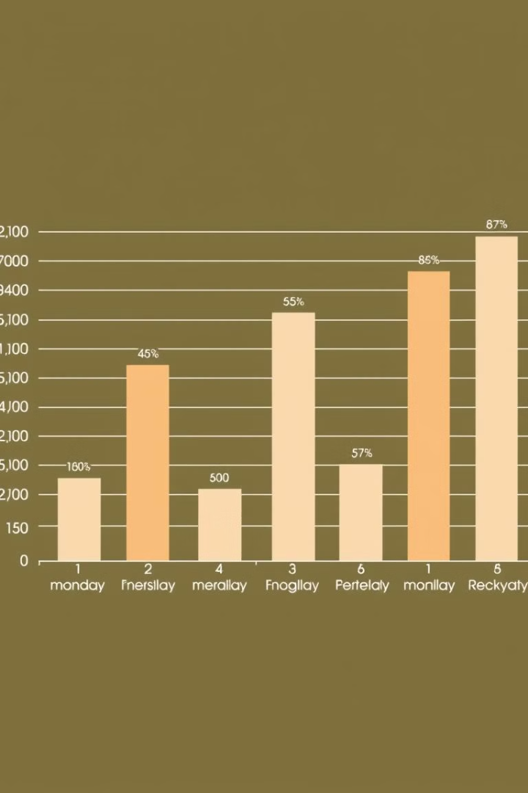



Combining Aggregate Functions and Grouping
Grouping by Product Category
Group the sales data by product category.
Applying SUM Function
Use the SUM function to calculate the total sales for each category.
Result
Obtain a summarized table of total sales for each product category.

Slide 7




Optimizing Aggregate Queries
Index Usage
Use indexes on the columns involved in grouping and aggregation to improve query performance.
Data Partitioning
Partition data based on relevant criteria to reduce the amount of data processed by aggregate operations.
Query Rewriting
Rewrite queries to make them more efficient by using appropriate techniques like query hints or subqueries.

Slide 8

Visualizing Aggregate Data using Related Pics
Aggregate data is highly valuable when visualized effectively. This provides insights into trends, outliers, and patterns in data.

Slide 9


